Slide 1
Are you ready?
git clone https://github.com/infusion-wro/infusion.js

Slide 2
Infusion.js #2
React Intro + JSX Dawid Cech Tomek Łaszkiewicz 06/04/2017 Wrocław

Slide 3
Infusion.js? YES!
Why? Who? When? What?
Confluence: link
Slack #infusionjs link
Notes:
We want to be a master in JS ecosystem. We want to create a team, group of people, who have a deep understanding of at least one top popular JS technology.
Everyone – I’m not an expert – you don’t have to too ☺
Every two weeks – we already have a plan for 9 meetings
What: React

Slide 4

React!
Popular
Stable
Works
Component philosophy
Efficient
Maintained by Facebook
Bonus: Native

Slide 5

Book: Pro React
Amazon
Helion

Slide 6
JavaScript dark history

Slide 7
JavaScript basis

Slide 8
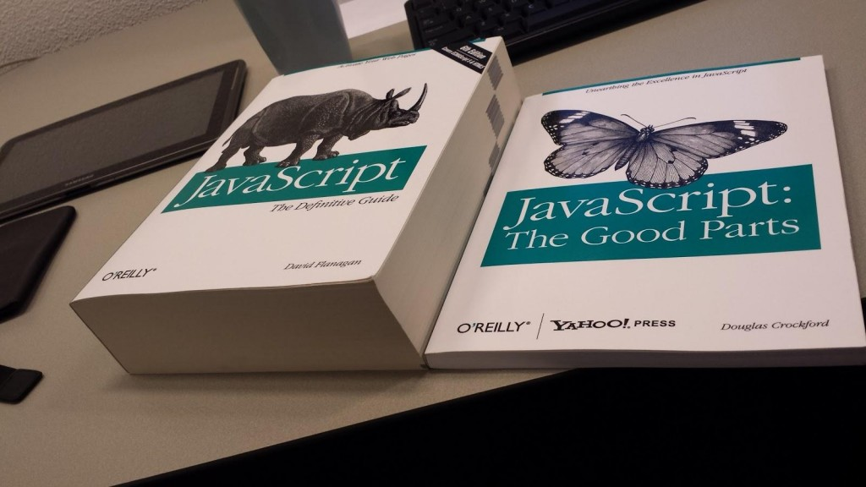
always look on the bright side of js

Slide 9


IDE – ale gdzie?
vs

Slide 10
Atom
Created by GitHub
Cross-platform
Built-in package manager
Smart autocompletion
Open source
Popular

Slide 11
VS Code
Created by Microsoft
Cross-platform
Built-in package manager
Smart autocompletion
Open source
Popular

Slide 12

ECMAScript 2015
Notes:
ES2015 is the most extensive update to the JavaScript language since the publication of its first edition in 1997.

Slide 13
let and const
Cure for sick var
Hint:
Don’t use var !
Prefer const
Notes:
let variables are scoped to the nearest block and are NOT hoisted.

Slide 14
Functions
Default parameter value
Rest
Spread
Arrow functions
Notes:
MD

Slide 15
Objects
Don’t repeat yourself
Be destructive
Be concise

Slide 16
Template strings
`
Not “ and ‘

Slide 17
Object.assign
The Object.assign method copies properties from one or more source objects to a target object specified as the very first argument
Object.assign({}, defaults, options1, options2, options3)

Slide 18
Collections
Array – what new?
Maps
Sets
Notes:
MD

Slide 19
Promises
Notes:
MD

Slide 20
Classes
Syntatic sugar for constructor function
But still sweet
Notes:
The class syntax is not introducing a new object model to JavaScript. It’s just syntactical sugar over the existing prototype-based inheritance.

Slide 21
Modules
Avoid polluting global namespaces
Very important for React
Notes:
The class syntax is not introducing a new object model to JavaScript. It’s just syntactical sugar over the existing prototype-based inheritance.

Slide 22
Async ES2017
Notes:
MD

Slide 23
Thank you

